Slide 1
Neural Networks
Course 1

Slide 2
Overview
Course evaluation
Machine learning concepts
Basic Linear Algebra
Numpy
  Datatype
  Arrays
  Shapes
  Indexing & slicing
  Operations
  Serialization

Slide 3
Course Evaluation

Slide 4
Evaluation
Course Requirements
Laboratory Requirements
40% of final grade
Points will be received from a final test that will take place during the examination session
Minimum 35 points out of 100
60% of final grade
Points can be received by completing 5 assignments
Minimum 35 points out of 100

Slide 5
Evaluation
More about the Laboratory:
(subject to change)
100 points divided in 5 assignments:
  First Half of the semester:
    Assignment 1: 10 points (Deadline: 3rd week)
    Assignment 2: 15 points (Deadline: 4th week)
    Assignment 3: 30 points (Deadline: 7th week)
  Second Half of the semester
    Assignment 4: 15 points (Deadline: 10th week)
    Assignment 5: 30 points (Deadline: 13th week)

Slide 6
Evaluation
More about the Laboratory:
Assignments must be solved using python, numpy and pytorch
During the first half of the semester:
no machine learning framework must be used
During the second half of the semester:
using the pytorch machine learning framework

Slide 7
Basic Neural Network Elements
Overview of neural networks

Slide 8
What is AI ?
A.I.(Artificial Intelligence) refers to the simulation of human intelligence in machines.
In practice – we can consider this form of simulation an approximation on what we (human) consider intelligence.

Slide 9


What is AI ?
Let’s see a simple example:
How can we translate this behavior/functionality to a computer ?
We look at an
animal
And we
recognize it
Horse

Slide 10

What is AI ?
Let’s see a simple example:
First, we need the ability “to look” → this simply translate into taking a picture
That picture is transferred to a computer where it is converted into a matrix of (w x h), where “w” is the width of the picture and “h” is its height. Each cell of that matrix is a color (a numerical value) that reflects the color of the pixels from the original picture.
We convert the matrix into a vector of numbers by concatenating each row one after another
Now we need a function that takes “w” x “h” parameters (let’s call it function f), and returns a number with a very special meaning: if the result is 1, it corresponds to the word “horse”, if the result is 2, it corresponds to the word “cat’ and so on.
Finally, we use a map with associations (1➔ horse, 2➔ cat, …) and we print the result.
Human behavior | Computer behavior
We look at an
animal
And we
recognize it
Horse

Slide 11
What is AI ?
Let’s see a simple example:
First, we need the ability “to look” → this simply translate into taking a picture
That picture is transferred to a computer where it is converted into a matrix of (w x h), where “w” is the width of the picture and “h” is its height. Each cell of that matrix is a color (a numerical value) that reflects the color of the pixels from the original picture.
We convert the matrix into a vector of numbers by concatenating each row one after another
Now we need a function that takes “w” x “h” parameters (let’s call it function f), and returns a number with a very special meaning: if the result is 1, it corresponds to the word “horse”, if the result is 2, it corresponds to the word “cat’ and so on.
Finally, we use a map with associations (1➔ horse, 2➔ cat, …) and we print the result.
Human behavior | Computer behavior
We look at an
animal
And we
recognize it
Horse

Slide 12
What is AI ?
Let’s see a simple example:
First, we need the ability “to look” → this simply translate into taking a picture
That picture is transferred to a computer where it is converted into a matrix of (w x h), where “w” is the width of the picture and “h” is its height. Each cell of that matrix is a color (a numerical value) that reflects the color of the pixels from the original picture.
We convert the matrix into a vector of numbers by concatenating each row one after another
Now we need a function that takes “w” x “h” parameters (let’s call it function f), and returns a number with a very special meaning: if the result is 1, it corresponds to the word “horse”, if the result is 2, it corresponds to the word “cat’ and so on.
Finally, we use a map with associations (1➔ horse, 2➔ cat, …) and we print the result.
Human behavior | Computer behavior
We look at an
animal
And we
recognize it
Horse

Slide 13
What is AI ?
Let’s see a simple example:
First, we need the ability “to look” → this simply translate into taking a picture
That picture is transferred to a computer where it is converted into a matrix of (w x h), where “w” is the width of the picture and “h” is its height. Each cell of that matrix is a color (a numerical value) that reflects the color of the pixels from the original picture.
We convert the matrix into a vector of numbers by concatenating each row one after another
Now we need a function that takes “w” x “h” parameters (let’s call it function f), and returns a number with a very special meaning: if the result is 1, it corresponds to the word “horse”, if the result is 2, it corresponds to the word “cat’ and so on.
Finally, we use a map with associations (1➔ horse, 2➔ cat, …) and we print the result.
Human behavior | Computer behavior
f(…)
We look at an
animal
And we
recognize it
Horse

Slide 14
What is AI ?
Let’s see a simple example:
First, we need the ability “to look” → this simply translate into taking a picture
That picture is transferred to a computer where it is converted into a matrix of (w x h), where “w” is the width of the picture and “h” is its height. Each cell of that matrix is a color (a numerical value) that reflects the color of the pixels from the original picture.
We convert the matrix into a vector of numbers by concatenating each row one after another
Now we need a function that takes “w” x “h” parameters (let’s call it function f), and returns a number with a very special meaning: if the result is 1, it corresponds to the word “horse”, if the result is 2, it corresponds to the word “cat’ and so on.
Finally, we use a map with associations (1➔ horse, 2➔ cat, …) and we print the result.
Human behavior | Computer behavior
f(…)
1 → horse
2 → cat
…
We look at an
animal
And we
recognize it
Horse
Horse

Slide 15
What is AI ?
Let’s see a simple example:
First, we need the ability “to look” → this simply translate into taking a picture
That picture is transferred to a computer where it is converted into a matrix of (w x h), where “w” is the width of the picture and “h” is its height. Each cell of that matrix is a color (a numerical value) that reflects the color of the pixels from the original picture.
We convert the matrix into a vector of numbers by concatenating each row one after another
Now we need a function that takes “w” x “h” parameters (let’s call it function f), and returns a number with a very special meaning: if the result is 1, it corresponds to the word “horse”, if the result is 2, it corresponds to the word “cat’ and so on.
Finally, we use a map with associations (1➔ horse, 2➔ cat, …) and we print the result.
Human behavior | Computer behavior
f(…)
1 → horse
2 → cat
…
We look at an
animal
And we
recognize it
Horse
Horse
This is where the magic happens.
The question is how do we find this function or if it exists ?

Slide 16
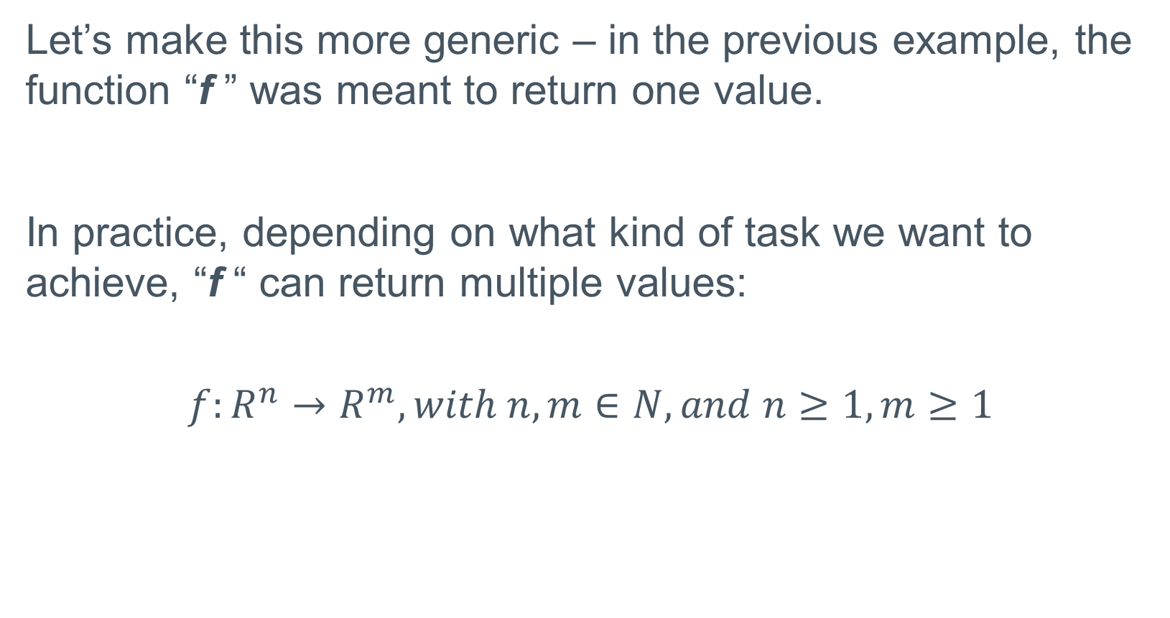
What is AI ?
Let’s make this more generic – in the previous example, the function “f ” was meant to return one value.
In practice, depending on what kind of task we want to achieve, “f “ can return multiple values:
$$f:R^{n}→R^{m}, with n,m∈N, and n≥1, m≥1$$

Slide 17
What is AI ?
So … the question here is → Is there a function f that can satisfy our requirements ?
The answer is that we should not search for an exact function, but one that approximates the results as much as possible !
The function that we find (meaning its form and its parameters) is called a model !

Slide 18

What is AI ?
Let’s consider that for a specific problem, we manage to find a function f that looks like the following:
$$f\left(x,y,z\right)=5x+9y−10z$$
For this example, we can say that the model is [5, 9 and -10]

Slide 19
What is AI ?
So … the new question is how can we approximate a function/model that has to obtain a specific value ?
Or even more, assuming we have such a function/model, how can we measure its effectiveness ?

Slide 20
What is AI ?
To answer both these questions – we will need a dataset.
A data set (for classification) is a set of entries where we know their output. For example, assuming we are trying to find the function “add ” for two numbers, the data set will look like this:
Input for the function
Entry | x₁ | x₂ | Output (x₁+x₂)
#1 | 5 | 20 | 25
#2 | 2 | 7 | 9
#3 | -11 | 100 | 89
#4 | 30 | 30 | 60
#5 | 0 | 0 | 0
… | ... | … | …
#n | 12 | 11 | 23

Slide 21
What is AI ?
Having access to a database allows us to:
Use several techniques to approximate the output as best as we can
Validate that the output is the one that we expect.

Slide 22
What is AI ?
Having access to a database allows us to:
Use several techniques to approximate the output as best as we can
Validate that the output is the one that we expect.
One simple example is the Lagrange Interpolation technique (that even if initially design to work with 2-dimensional points) is a good start in understanding how A.I. works.

Slide 23
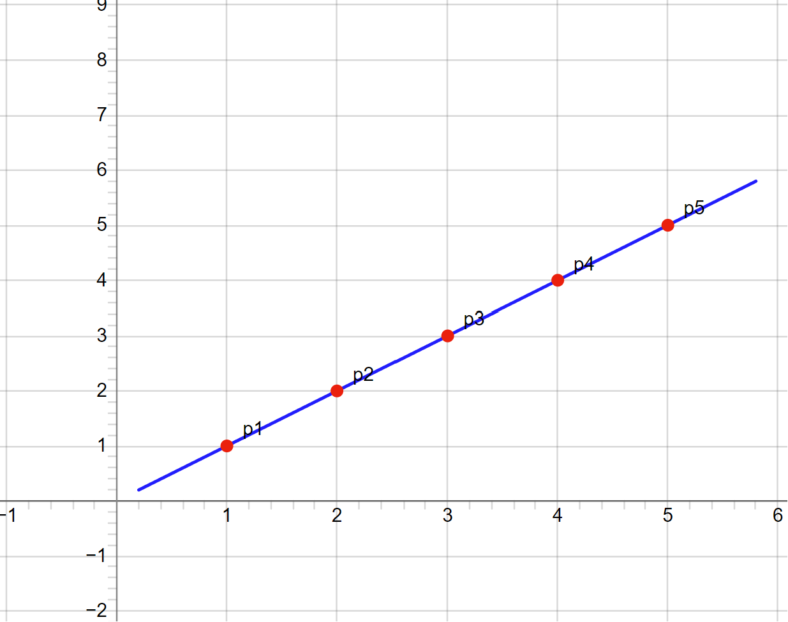
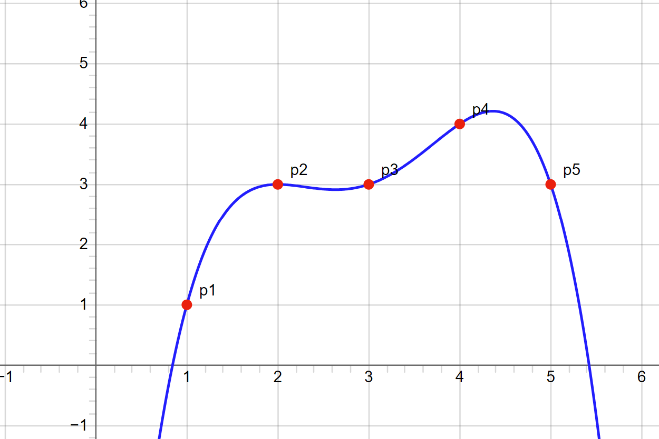
What is AI ?
Lagrange interpolation – given a set of points, identify a function “f ” that approximates “Y” given an “X” ➔ f(x) = y

Slide 24
What is AI ?
Having access to a database allows us to:
Use several techniques to approximate the output as best as we can
Validate that the output is the one that we expect.
The main question here is how can we measure this ?

Slide 25
What is AI ?
How to validate A.I. ?
There are several options that can be used to test this:
The database has to be split into several parts (some to be used to identify the function “f “, others for validation of that function
We will need some metrics (to validate how good the resulted function is).

Slide 26
What is AI ?
How to validate A.I. ?
First – lets see how we can split a database:
Entry | Field
#1 | Data₁
#2 | Data₂
#3 | Data₃
#4 | Data₄
#5 | Data₅
#6 | Data₆
#7 | Data₇
#8 | Data₈
…
#n | Data_{n}
Training data set (used to obtain/train the f function)
Validation data set (used to fine tune the result)
Test data set (used to validate the result)

Slide 27
What is AI ?
How to validate A.I. ?
First – lets see how we can split a database:
Entry | Field
#1 | Data₁
#2 | Data₂
#3 | Data₃
#4 | Data₄
#5 | Data₅
#6 | Data₆
#7 | Data₇
#8 | Data₈
…
#n | Data_{n}
It’s important to select a proper balance between these data sets. For example, if the training set is too small while the test set is too large, the results will be inconclusive as the algorithm will not have enough data to learn from. Similarly, if no test/validation data set is available (or too small), the results may not be validated properly, or an overfitting state can be achieved.
Training data set
Validation data set
Test data set

Slide 28
What is AI ?
Overfitting
Overfitting refers to a modeling error that occurs when a machine learning algorithm captures noise in the training data rather than the underlying data distribution. This results in a model that performs well on the training data but poorly on new data, because it has essentially "memorized" the training data rather than generalizing from it.

Slide 29


What is AI ?
Overfitting
Let’s see an example (we will consider a data set of 4 entries where the first 3 entries are used for training, and the last one for validation.
Dataset | x₁ | f (x₁)
#1 (training) | 1 | 2
#2 (training) | 2 | 4
#3 (training) | 3 | 6
#4 (test/validation) | 4 | 8
$$f\left(x\right)=x×2$$
Case 1
$$f\left(x\right)=\left\{\begin{aligned}\begin{aligned}2, x=1 \\ &4, x=2\end{aligned} \\ 6, x=3 \\ 0, x∉\{1,2,3\}\end{aligned}\right.$$
Case 2
Generic solution
f(4) = 8
Overfitting
f(4) = 0

Slide 30
What is AI ?
How to validate A.I. ?
First – lets see how we can split a database:
Entry | Field
#1 | Data₁
#2 | Data₂
#3 | Data₃
#4 | Data₄
#5 | Data₅
#6 | Data₆
#7 | Data₇
#8 | Data₈
…
#n | Data_{n}
The validation data set is OPTIONAL
Some percentages commonly used:
60/20/20 (60% training, 20% validation, 20% testing)
70/15/15 (70% training, 15% validation, 15% testing)
80/10/10 (80% training, 10% validation, 10% testing)
Training data set
Validation data set
Test data set

Slide 31
What is AI ?
How to validate A.I. ?
First – lets see how we can split a database:
Entry | Field
#1 | Data₁
#2 | Data₂
#3 | Data₃
#4 | Data₄
#5 | Data₅
#6 | Data₆
#7 | Data₇
#8 | Data₈
…
#n | Data_{n}
The validation and testing data set don’t have to be equals.
If you perform hyper-parameter tuning → it is recommended to use a larger validation data set
If you want the result to be more generic, and have a better check and a more reliable result → it is recommended to use a larger test data set.
Training data set
Validation data set
Test data set

Slide 32
What is AI ?
How to validate A.I. ?
Another solution on how to split a database is to use a technique called k-fold cross-validation. The idea is to split the entire database into “k” partition, and then use (k-1) partitions for training and the partition that remains for testing. The validation is performed for “k” times (each time using a different partition for testing).
1 | 2 | 3 |  | 5 | 6 | 7 | 8
For example, in this case we use partition 1,2,3,5,6,7,8 to train and partition 4 for testing (in a 8-fold cross validation)

Slide 33
What is AI ?
How to validate A.I. ?
Before we discuss metrics to evaluate, lets first discuss about type of artificial intelligence algorithms:
Supervised learning - the model is trained on a labeled dataset, meaning the algorithm is provided with input-output pairs.
Unsupervised learning - works with unlabeled data. The goal is to find patterns or structures in the data. One such example are clustering algorithms
Other variations:
  Reinforcement learning
  Semi-supervised learning
  …

Slide 34
What is AI ?
How to validate A.I. ?
When talking about supervised learning a machine learning algorithm can be classified (taking into consideration the output) in:
Single class (binary models) - Classify instances into one of two classes. For example , in our example that tries to identify a picture and find a horse, the output of a function can be 1 (TRUE) or 0 (FALSE).
Multi class - Classify instances into one of more than two classes. For the same example, the output of the function could be 1 (for a Horse), 2 for a Monkey, 3 for a Cat, ….

Slide 35


What is AI ?
How to validate A.I. ?
To better explain how several metrics work, lets consider a supervised single class machine learning that attempts to identify pictures with cats from a data base.
Response is that the picture is with a cat.
Response is that the picture is NOT with a cat.
Picture with
a cat
TRUE POSITIVE
FALSE NEGATIVE
Picture with
an eagle
FALSE POSITIVE
TRUE NEGATIVE

Slide 36
What is AI ?
How to validate A.I. ?
Let’s assume that we have the following data base:
True Positives (TP) = 4
(entries #1, #4, #8, #9)
Index | Actual label / Desired output | Result of the model
#1 | CAT | CAT
#2 | CAT | Not A Cat
#3 | Not A Cat | CAT
#4 | CAT | CAT
#5 | Not A Cat | Not A Cat
#6 | Not A Cat | Not A Cat
#7 | Not A Cat | CAT
#8 | CAT | CAT
#9 | CAT | CAT

Slide 37
What is AI ?
How to validate A.I. ?
Let’s assume that we have the following data base:
True Positives (TP) = 4
(entries #1, #4, #8, #9)
Index | Actual label / Desired output | Result of the model
#1 | CAT | CAT
#2 | CAT | Not A Cat
#3 | Not A Cat | CAT
#4 | CAT | CAT
#5 | Not A Cat | Not A Cat
#6 | Not A Cat | Not A Cat
#7 | Not A Cat | CAT
#8 | CAT | CAT
#9 | CAT | CAT
True Negatives (TN) = 2
(entries #5, #6)

Slide 38
What is AI ?
How to validate A.I. ?
Let’s assume that we have the following data base:
True Positives (TP) = 4
(entries #1, #4, #8, #9)
Index | Actual label / Desired output | Result of the model
#1 | CAT | CAT
#2 | CAT | Not A Cat
#3 | Not A Cat | CAT
#4 | CAT | CAT
#5 | Not A Cat | Not A Cat
#6 | Not A Cat | Not A Cat
#7 | Not A Cat | CAT
#8 | CAT | CAT
#9 | CAT | CAT
True Negatives (TN) = 2
(entries #5, #6)
False Negatives (FN) = 1
(entry #2)

Slide 39
What is AI ?
How to validate A.I. ?
Let’s assume that we have the following data base:
True Positives (TP) = 4
(entries #1, #4, #8, #9)
Index | Actual label / Desired output | Result of the model
#1 | CAT | CAT
#2 | CAT | Not A Cat
#3 | Not A Cat | CAT
#4 | CAT | CAT
#5 | Not A Cat | Not A Cat
#6 | Not A Cat | Not A Cat
#7 | Not A Cat | CAT
#8 | CAT | CAT
#9 | CAT | CAT
True Negatives (TN) = 2
(entries #5, #6)
False Negatives (FN) = 1
(entry #2)
False Positives (FP) = 2
(entries #3, #7)

Slide 40
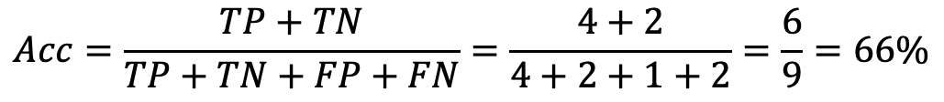
What is AI ?
How to validate A.I. ?
With this values computed we can evaluate several metrics:
Accuracy (Acc)
True Positives (TP) = 4
(entries #1, #4, #8, #9)
$$Acc=\frac{TP+TN}{TP+TN+FP+FN}=\frac{4+2}{4+2+1+2}=\frac{6}{9}=66\%$$
True Negatives (TN) = 2
(entries #5, #6)
False Negatives (FN) = 1
(entry #2)
accuracy is a measure of the correctness of a model's predictions , in other words how many samples were correctly classified from the test set. It is good for a balanced data set.
False Positives (FP) = 2
(entries #3, #7)

Slide 41

What is AI ?
How to validate A.I. ?
With this values computed we can evaluate several metrics:
False Positive Rate (FPR)
True Positives (TP) = 4
(entries #1, #4, #8, #9)
$$FPR=\frac{FP}{FP+TN}=\frac{2}{2+2}=\frac{2}{4}=50\%$$
True Negatives (TN) = 2
(entries #5, #6)
False Negatives (FN) = 1
(entry #2)
proportion of negative instances that are incorrectly classified as positive
False Positives (FP) = 2
(entries #3, #7)
Notes:
FPR = care e rata mea de FP-uri
Specificity = care e rata mea de detectat false negatives

Slide 42

What is AI ?
How to validate A.I. ?
With this values computed we can evaluate several metrics:
False Negative Rate (FNR)
True Positives (TP) = 4
(entries #1, #4, #8, #9)
$$FNR=\frac{FN}{FN+TP}=\frac{1}{1+4}=\frac{1}{5}=20\%$$
True Negatives (TN) = 2
(entries #5, #6)
False Negatives (FN) = 1
(entry #2)
proportion of positive instances that are incorrectly classified as negative
False Positives (FP) = 2
(entries #3, #7)
Notes:
False Negative = Cat am ratat din ce trebuia sa detectez
Recall/Sensititviy = Cat am nimerit din ce trebuia sa detectez

Slide 43

What is AI ?
How to validate A.I. ?
With this values computed we can evaluate several metrics:
Precision
True Positives (TP) = 4
(entries #1, #4, #8, #9)
$$Precision=\frac{TP}{TP+FP}=\frac{4}{4+2}=\frac{4}{6}=66\%$$
True Negatives (TN) = 2
(entries #5, #6)
False Negatives (FN) = 1
(entry #2)
Evaluate the correctness of positive predictions (it is in particular valuable for models where TP is relevant → for example a classifier that tries to determine if a disease is present or not).
False Positives (FP) = 2
(entries #3, #7)
Notes:
How relevant are samples retrived.
Cat din cele pe care am dat eu raspunsul de pisica, sunt intradevar pisici

Slide 44

What is AI ?
How to validate A.I. ?
With this values computed we can evaluate several metrics:
Recall or Sensitivity (Se)
True Positives (TP) = 4
(entries #1, #4, #8, #9)
$$Se=\frac{TP}{TP+FN}=\frac{4}{4+1}=\frac{4}{5}=80\%$$
True Negatives (TN) = 2
(entries #5, #6)
False Negatives (FN) = 1
(entry #2)
Shows how many positive instances the model might be missing. Relevant for scenarios where failing to identify a positive instance has significant consequences. Also known as True Positive Rate.
False Positives (FP) = 2
(entries #3, #7)
Notes:
The amount relevant samples retrieved
False Negative = Cat am ratat din ce trebuia sa detectez
Recall/Sensititviy = Cat am nimerit din ce trebuia sa detectez (invers la false negative)

Slide 45

What is AI ?
How to validate A.I. ?
With this values computed we can evaluate several metrics:
Specificity (Sp)
True Positives (TP) = 4
(entries #1, #4, #8, #9)
$$Sp=\frac{TN}{TN+FP}=\frac{2}{2+2}=\frac{2}{4}=50\%$$
True Negatives (TN) = 2
(entries #5, #6)
False Negatives (FN) = 1
(entry #2)
Evaluates how well the model identifies negative instances and avoids false alarms. Also known as True Negative Rate.
False Positives (FP) = 2
(entries #3, #7)
Notes:
False Negative = Cat am ratat din ce trebuia sa detectez
Recall/Sensititviy = Cat am nimerit din ce trebuia sa detectez

Slide 46
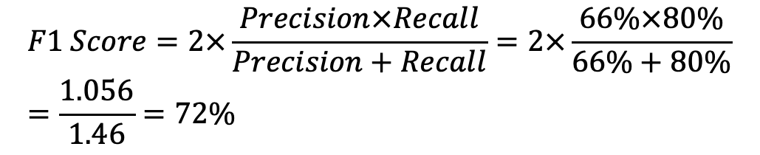
What is AI ?
How to validate A.I. ?
With this values computed we can evaluate several metrics:
F1 Score
True Positives (TP) = 4
(entries #1, #4, #8, #9)
$$F1 Score=2×\frac{Precision×Recall}{Precision+Recall}=2×\frac{66\%×80\%}{66\%+80\%}=\frac{1.056}{1.46}=72\%$$
True Negatives (TN) = 2
(entries #5, #6)
False Negatives (FN) = 1
(entry #2)
Useful when both false positives and false negatives are crucial and for cases where data set is unbalanced (the number of entries of one class is far bigger than the entries of another class).
False Positives (FP) = 2
(entries #3, #7)
Notes:
Harmonic Mean.

Slide 47
What is AI ?
How to validate A.I. ?
Now, lets see how a model can be validated using a 3-fold cross validation and the FPR metric. To simplify the problem lets consider that the database is formed out of 3 partition A, B and C (all equal in size).
Index | Values
#1 | V_{(1.1)}…V_{(1,n)}
…
#k | V_{(k.1)}…V_{(k,n)}
#k+1 | V_{(k+1.1)}…V_{(k+1,n)}
…
#2k | V_{(2k.1)}…V_{(2k,n)}
#2k+1 | V_{(2k+1.1)}…V_{(2k+1,n)}
…
#3k | V_{(3k.1)}…V_{(3k,n)}
Train | Test | FPR
A+B | C | 5%
A+C | B | 4%
B+C | A | 3%
A
B
This means that the average value for FPR is (3%+4%+5%)/3 = 4%. This value represents how well the model behaves on this data set.
C

Slide 48
Basic linear algebra notions

Slide 49
Basic notions
Before we start, lets discuss some basic notions used in linear algebra that we will further use in our course:
  Scalar
  Vector
  Matrix
And some operations:
  vector
  matrixes

Slide 50

Basic notions
Scalar = a single numerical value that describes a quantity (e.g. 100 or 5.6 or -1.45)
Vector = a list of scalar values. The number of scalar values within a vector is often referred to as dimension.
example:
$v= \left[\begin{aligned}10 \\ 20 \\ 30 \\ 40 \\ 50\end{aligned}\right]$ or $v$= [10, 20, 30, 40, 50]

Slide 51

Basic notions
Matrix = a n-dimensional array of scalar elements (in mathematics the term matrix is often used to refer to a bi-dimensional array). From this point of view, we can think that a matrix is a vector of vectors of scalars, with the condition that each vector of scalars have the same number of elements).
Example:
$$m= \left[\begin{matrix}1 & 2 & 3 \\ 100 & 200 & 300\end{matrix}\right], m is a 2×3 matrix$$

Slide 52

Basic notions
Both matrixes and vectors have a property called shape. We can think about a shape as a tuple of integer values, each one representing the number of elements for each dimension from the matrix.
Example:
$$v=\left[\begin{matrix}100 & 200 & 300\end{matrix}\right], shape\left(v\right)=\left(3\right)$$
$$m= \left[\begin{matrix}1 & 2 & 3 \\ 100 & 200 & 300\end{matrix}\right], shape\left(m\right)=(2,3)$$

Slide 53
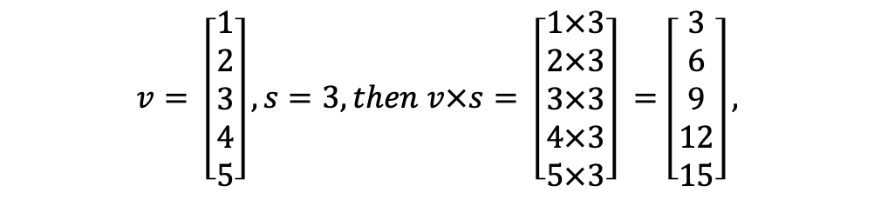

Basic operations (vectors)
Scalar multiplication
For v = [v₁,v₂,..v_{n}] a vector, and “s” a scalar, we define:
$$v×s= \left[\begin{matrix}v_{1}×s \\ v_{2}×s \\ \begin{aligned}⋮ \\ v_{n}×s\end{aligned}\end{matrix}\right]$$
Example:
$$v= \left[\begin{aligned}1 \\ 2 \\ 3 \\ 4 \\ 5\end{aligned}\right], s=3, then v×s= \left[\begin{aligned}1×3 \\ 2×3 \\ 3×3 \\ 4×3 \\ 5×3\end{aligned}\right] =\left[\begin{aligned}3 \\ 6 \\ 9 \\ 12 \\ 15\end{aligned}\right],$$

Slide 54


Basic operations (vectors)
Dot product
For v = [v₁,v₂,..v_{n}] a vector, and u = [u₁,u₂,..u_{n}] another vector, we define the dot product as follows:
$v ∙u= \sum_{i=1}^{n}{{(v}_{i}×u_{i})}$
Example:
$$v= \left[\begin{aligned}1 \\ 2 \\ 3 \\ 4\end{aligned}\right],u= \left[\begin{aligned}−2 \\ 4 \\ 0 \\ 3\end{aligned}\right],then v∙s=\left(1×−2\right)+\left(2×4\right)+\left(3×0\right)+\left(4×3\right)=−2+8+0+12=18$$

Slide 55
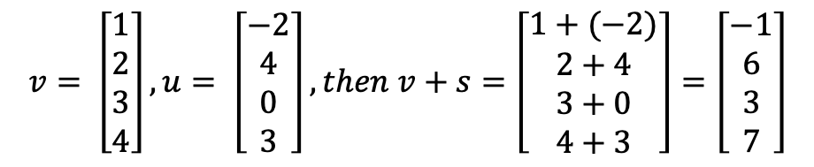

Basic operations (vectors)
Addition/Subscription of two vectors
For v = [v₁,v₂,..v_{n}] a vector, and u = [u₁,u₂,..u_{n}] another vector, we define the sum and difference as follows:
$v+u= \left[\begin{matrix}v_{1}+u_{1} \\ v_{2}+u_{2} \\ \begin{aligned}⋮ \\ v_{n}+u_{n}\end{aligned}\end{matrix}\right],and v−u= \left[\begin{matrix}v_{1}−u_{1} \\ v_{2}−u_{2} \\ \begin{aligned}⋮ \\ v_{n}−u_{n}\end{aligned}\end{matrix}\right]$
Example:
$$v= \left[\begin{aligned}1 \\ 2 \\ 3 \\ 4\end{aligned}\right],u= \left[\begin{aligned}−2 \\ 4 \\ 0 \\ 3\end{aligned}\right],then v+s=\left[\begin{aligned}1+(−2) \\ 2+4 \\ 3+0 \\ 4+3\end{aligned}\right]=\left[\begin{aligned}−1 \\ 6 \\ 3 \\ 7\end{aligned}\right]$$

Slide 56

Basic operations (vectors)
Norm
For v = [v₁,v₂,..v_{n}] a vector, its norm is defined as follows:
${\left\|v\right\|}_{k}=\sqrt[k]{\sum_{i=1}^{n}{{\left|v_{i}\right|}^{k}}}$
Depending on the value of “k”, a norm can be:
  k=1 → Manhattan norm
  k=2 → Euclidian norm
All norms satisfy certain properties, such as non-negativity, the triangle inequality, and homogeneity.
Notes:
Homogeneity of a norm is the property that, for any vector v and any scalar c, the norm of the scaled vector cv is equal to the absolute value of the scalar c times the norm of the original vector v
Norma produsului scalar este egal cu produsul intre scalar si norma.

Slide 57

Basic operations (vectors)
Distance
For v = [v₁,v₂,..v_{n}] a vector, and u = [u₁,u₂,..u_{n}] another vector, we define the distance between v and u as:
${dist}_{k}(v,u)={\left\|v−u\right\|}_{k}$
Depending on the value of “k”, a distance can be:
  k=1 → Manhattan norm
  k=2 → Euclidian norm
As a general consideration, dist_{k} is also called Minkovsky distance.

Slide 58
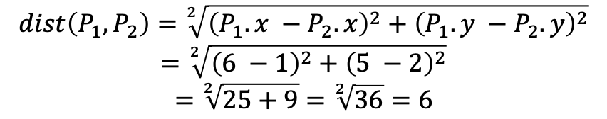
Basic operations (vectors)
Distance
Let’s see an example (we will consider a 2-dimensional space).
6
5
4
3
2
1
0
 | 0 | 1 | 2 | 3 | 4 | 5 | 6 | 7 | 8
We can compute the distance based on a simple distance formula !
P₁(6,5)
P₂(1,2)
$$dist\left(P_{1},P_{2}\right)=\sqrt[2]{{\left(P_{1}.x −P_{2}.x\right)}^{2}+{\left(P_{1}.y −P_{2}.y\right)}^{2}}$$
$$=\sqrt[2]{{\left(6 −1\right)}^{2}+{\left(5 −2\right)}^{2}}$$
$$=\sqrt[2]{25+9}=\sqrt[2]{36}=6$$
Notes:
Poate sa dispara

Slide 59
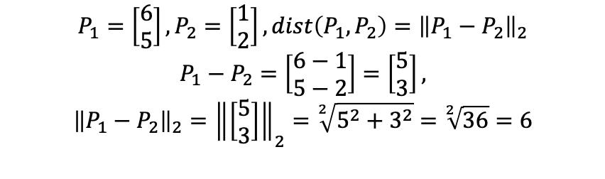
Basic operations (vectors)
Distance
Let’s see an example (we will consider a 2-dimensional space).
6
5
4
3
2
1
0
 | 0 | 1 | 2 | 3 | 4 | 5 | 6 | 7 | 8
P₁(6,5)
Or we can consider P₁ and P₂ two bidimensional vectors and use the norm.
P₂(1,2)
$$P_{1}=\left[\begin{aligned}6 \\ 5\end{aligned}\right],P_{2}=\left[\begin{aligned}1 \\ 2\end{aligned}\right], dist\left(P_{1},P_{2}\right)={\left\|P_{1}−P_{2}\right\|}_{2}$$
$$P_{1}−P_{2}=\left[\begin{aligned}6−1 \\ 5−2\end{aligned}\right]=\left[\begin{aligned}5 \\ 3\end{aligned}\right],$$
$${\left\|P_{1}−P_{2}\right\|}_{2}={\left\|\left[\begin{aligned}5 \\ 3\end{aligned}\right]\right\|}_{2}=\sqrt[2]{5^{2}+3^{2}}=\sqrt[2]{36}=6$$

Slide 60
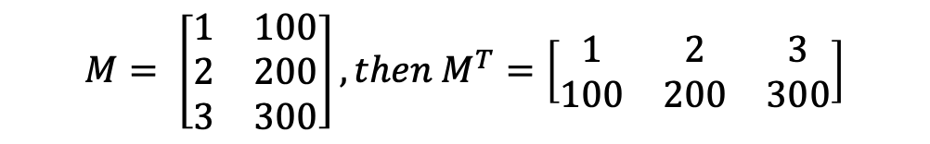

Basic operations (matrices)
Matrix transposition
Given a matrix “M” of shape n x m, the transpose of that matrix will be obtained by interchanging rows with columns:
$$M=\left[\begin{matrix}m_{(1,1)} & ⋯ & m_{(1,m)} \\ ⋮ & ⋱ & ⋮ \\ m_{(n,1)} & ⋯ & m_{(n,m)}\end{matrix}\right],then M^{T}=\left[\begin{matrix}m_{(1,1)} & ⋯ & m_{(n,1)} \\ ⋮ & ⋱ & ⋮ \\ m_{(1,,)} & ⋯ & m_{(n,m)}\end{matrix}\right]$$
Example:
$$M= \left[\begin{matrix}1 & 100 \\ 2 & 200 \\ 3 & 300\end{matrix}\right],then M^{T}=\left[\begin{matrix}1 & 2 & 3 \\ 100 & 200 & 300\end{matrix}\right]$$

Slide 61
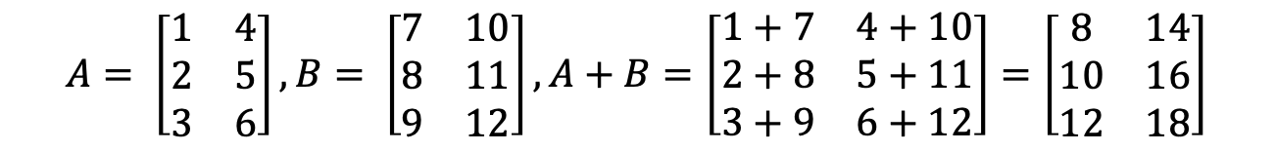

Basic operations (matrices)
Matrix addition / subtraction
Given two matrixes “A” and “B” with the same size: n x m:
$$A=\left[\begin{matrix}a_{(1,1)} & ⋯ & a_{(1,m)} \\ ⋮ & ⋱ & ⋮ \\ a_{(n,1)} & ⋯ & a_{(n,m)}\end{matrix}\right],B=\left[\begin{matrix}b_{(1,1)} & ⋯ & b_{(1,m)} \\ ⋮ & ⋱ & ⋮ \\ b_{(n,1)} & ⋯ & b_{(n,m)}\end{matrix}\right], A+B=\left[\begin{matrix}a_{(1,1)}+b_{(1,1)} & ⋯ & a_{\left(n,1\right)}+b_{(1,m)} \\ ⋮ & ⋱ & ⋮ \\ a_{(n,1)}+b_{(n,1)} & ⋯ & a_{\left(n,m\right)}+b_{(n,m)}\end{matrix}\right]$$
Example:
$$A= \left[\begin{matrix}1 & 4 \\ 2 & 5 \\ 3 & 6\end{matrix}\right],B= \left[\begin{matrix}7 & 10 \\ 8 & 11 \\ 9 & 12\end{matrix}\right],A+B=\left[\begin{matrix}1+7 & 4+10 \\ 2+8 & 5+11 \\ 3+9 & 6+12\end{matrix}\right]=\left[\begin{matrix}8 & 14 \\ 10 & 16 \\ 12 & 18\end{matrix}\right]$$

Slide 62
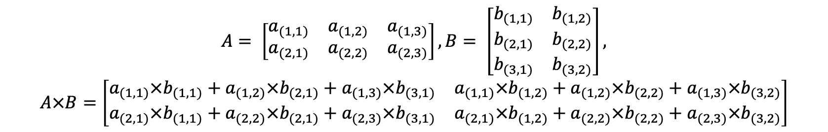

Basic operations (matrices)
Matrix multiplication
Given two matrixes “A” with size “n x m” and “B” with size “m x k” (meaning matrix “A” has the same number of columns as the number of rows from matrix “B”):
$$A=\left[\begin{matrix}a_{(1,1)} & ⋯ & a_{(1,m)} \\ ⋮ & ⋱ & ⋮ \\ a_{(n,1)} & ⋯ & a_{(n,m)}\end{matrix}\right],B=\left[\begin{matrix}b_{(1,1)} & ⋯ & b_{(1,p)} \\ ⋮ & ⋱ & ⋮ \\ b_{(m,1)} & ⋯ & b_{(m,p)}\end{matrix}\right], A×B=C, with C_{(i,j)}=\sum_{l=1}^{m}{a_{(i,l)}×b_{(l,j)}}$$
Example (2 x 3 matrix with a 3 x 2 matrix):
$$A= \left[\begin{matrix}a_{(1,1)} & a_{(1,2)} & a_{(1,3)} \\ a_{(2,1)} & a_{(2,2)} & a_{(2,3)}\end{matrix}\right],B= \left[\begin{matrix}b_{(1,1)} & b_{(1,2)} \\ b_{(2,1)} & b_{(2,2)} \\ b_{(3,1)} & b_{(3,2)}\end{matrix}\right],$$
$$A×B=\left[\begin{matrix}a_{(1,1)}×b_{(1,1)}+a_{(1,2)}×b_{(2,1)}+a_{(1,3)}×b_{(3,1)} & a_{(1,1)}×b_{(1,2)}+a_{(1,2)}×b_{(2,2)}+a_{(1,3)}×b_{(3,2)} \\ a_{(2,1)}×b_{(1,1)}+a_{(2,2)}×b_{(2,1)}+a_{(2,3)}×b_{(3,1)} & a_{(2,1)}×b_{(1,2)}+a_{(2,2)}×b_{(2,2)}+a_{(2,3)}×b_{(3,2)}\end{matrix}\right]$$

Slide 63

Basic operations (matrices)
Matrix multiplication
Let’s define two functions that can be applied over a matrix (col and row that create a vector out of a column or a row from a matrix.).
Let's consider the matrix A with size “n x m”
$$A=\left[\begin{matrix}a_{\left(1,1\right)} & ⋯ & a_{\left(1,m\right)} \\ ⋮ & ⋱ & ⋮ \\ a_{\left(n,1\right)} & ⋯ & a_{\left(n,m\right)}\end{matrix}\right],{col}_{i}\left(A\right)=\left[\begin{aligned}a_{(1,i)} \\ a_{(2,i)} \\ ⋮ \\ a_{(n,i)}\end{aligned}\right],{row}_{i}\left(A\right)=\left[\begin{aligned}a_{(i,1)} \\ a_{(i,2)} \\ ⋮ \\ a_{(i,m)}\end{aligned}\right]$$

Slide 64
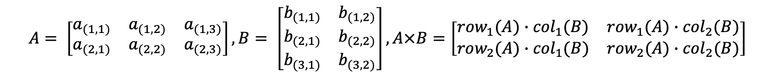

Basic operations (matrices)
Matrix multiplication
Then, we can write the matrix multiplication using the dot product of two vectors:
$$A=\left[\begin{matrix}a_{(1,1)} & ⋯ & a_{(1,m)} \\ ⋮ & ⋱ & ⋮ \\ a_{(n,1)} & ⋯ & a_{(n,m)}\end{matrix}\right],B=\left[\begin{matrix}b_{(1,1)} & ⋯ & b_{(1,p)} \\ ⋮ & ⋱ & ⋮ \\ b_{(m,1)} & ⋯ & b_{(m,p)}\end{matrix}\right],$$
$$A×B=C, with C_{(i,j)}={row}_{i}(A)∙{col}_{j}(B)$$
Example (2 x 3 matrix with a 3 x 2 matrix):
$$A= \left[\begin{matrix}a_{(1,1)} & a_{(1,2)} & a_{(1,3)} \\ a_{(2,1)} & a_{(2,2)} & a_{(2,3)}\end{matrix}\right],B= \left[\begin{matrix}b_{(1,1)} & b_{(1,2)} \\ b_{(2,1)} & b_{(2,2)} \\ b_{(3,1)} & b_{(3,2)}\end{matrix}\right],A×B=\left[\begin{matrix}{row}_{1}(A)∙{col}_{1}(B) & {row}_{1}(A)∙{col}_{2}(B) \\ {row}_{2}(A)∙{col}_{1}(B) & {row}_{2}(A)∙{col}_{2}(B)\end{matrix}\right]$$
This concept will further be relevant to the study of DENSE neural networks.

Slide 65
What is numpy

Slide 66
What is numpy
One of the most important Python’s mathematical modules, delivering high-speed numerical computing with a robust C/C++ backend for unparalleled efficiency.
Current version: 2.3 (28.09.2025)
Site: https://numpy.org/
Documentation: https://numpy.org/doc/stable/

Slide 67
What is numpy
To install numpy:
  Link: https://numpy.org/
  PIP: pip install numpy
  CONDA: conda install numpy
Compatibility (for latest version): Python 3.12
For best usage, we should use a version that is compatible with Python 3.11 (that will match latest version of PyTorch)

Slide 68
What is numpy
Support for:
  Arrays (ndarray)
  Mathematical functions (including basic arithmetic operations, statistical functions, algebraic operations, etc)
  Broadcasting (A powerful feature that allows NumPy to work with arrays of different shapes when performing arithmetic operations)
  Linear Algebra
  Indexing and Slicing
  FFT and Polynomials (Built-in support for Fast Fourier Transforms and polynomial operations).
  Support to save/load data into different formats

Slide 69
Data Types

Slide 70
Data types
NumPy supports a variety of numeric data types, which are essential for handling diverse computational requirements.
Integers:
  int8 : 8-bit signed integer (-128 to 127)
  int16 : 16-bit signed integer (-32768 to 32767)
  int32 : 32-bit signed integer (-2³¹ to 2³¹ -1)
  int64 : 64-bit signed integer (-2⁶³ to 2⁶³ -1)
Unsigned Integers:
  uint8 : 8-bit unsigned integer (0 to 255)
  uint16 : 16-bit unsigned integer (0 to 65535)
  uint32 : 32-bit unsigned integer (0 to 2³² -1)
  uint64 : 64-bit unsigned integer (0 to 2⁶⁴ -1)

Slide 71
Data types
NumPy supports a variety of numeric data types, which are essential for handling diverse computational requirements.
Floating Point:
  float16: Half precision float
  float32: Single precision float
  float64: Double precision float (default for float)
  float128: Extended precision float (not available on all platforms)
Complex Numbers:
  complex64: Complex number with two 32-bit floats (real and imaginary components)
  complex128: Complex number with two 64-bit floats
  complex256: Complex number with two 128-bit floats (not available on all platforms)

Slide 72
Data types
NumPy supports a variety of numeric data types, which are essential for handling diverse computational requirements.
Boolean:
  bool_: Boolean type storing True and False values
Strings:
  string_: Fixed-size string type
  unicode_: Fixed-size Unicode type
Datetime:
  datetime64: Date and time representation
  timedelta64: Represents the difference between two dates or times

Slide 73
Data types
Numerical data types are directly mapped to corresponding C (and occasionally C++) data types, ensuring both speed and compact memory usage.
The primary reason NumPy is so efficient compared to native Python lists or arrays is that it leverages these low-level languages (C/C++) for the storage and operations, avoiding the overhead of Python's dynamic typing and object-oriented features.

Slide 74
Data types
C/C++ type backend type mapping:
Numpy type | C/C++ type
int8 | Int8_t
int16 | int16_t
int32 | int32_t
int64 | int64_t
uint8 | uint8_t
uint16 | uint16_t
uint32 | uint32_t
uint64 | uint64_t
bool_ | bool
Numpy type | C/C++ type
float16 | Software representation
float32 | float
float64 | double
float128 | long double (depending on architecture)
complex64 | mapped to C structs containing two float
comples128 | mapped to C structs containing two double
Strings | Array of chars

Slide 75
Arrays (constructors)

Slide 76
Arrays
An array can be created using the method .array(…) defined as follows:
  .array( <data>, [type] ), where
    <data> is the raw data (one usual solution is to provide a list of values)
    [type] is an optional parameter that describes a possible scalar type for the data. If not provided, it will be inferred from the data type.
Example:
import numpy as np
a = np.array([1,2,3],dtype=np.int32)
print(a)
print(a.dtype)
Output
[1 2 3] int32

Slide 77
Arrays
You can also build an array with multiple dimensions (by providing lists within lists as the first parameter.
Example:
import numpy as np
a = np.array([[1,2,3],[4,5,6]],dtype=np.int32)
print(a)
print(a.dtype)
Output
[[1 2 3] [4 5 6]] int32

Slide 78
Arrays
Or a more complex matrix (in terms of shape and definition):
Example:
import numpy as np
a = np.array(
[
[
[1,2,3],[4,5,6],[7,8,9]
],
[
[10,20,30],[40,50,60],[70,80,90]
],
])
print(a)
print(a.dtype)
Output
[[[ 1 2 3] [ 4 5 6] [ 7 8 9]] [[10 20 30] [40 50 60] [70 80 90]]] int32

Slide 79
Arrays
However, keep in mind that when building n-dimensional arrays you have to respect the shape (sizes) for each list within the declaration.
Example:
import numpy as np
a = np.array([[1,2,3],[4,5]],dtype=np.int32)
print(a)
print(a.dtype)
Error
Traceback (most recent call last): File "E:\Lucru\RN\teste\a.py", line 3, in <module> a = np.array([[1,2,3],[4,5]],dtype=np.int32) ValueError: setting an array element with a sequence. The requested array has an inhomogeneous shape after 1 dimensions. The detected shape was (2,) + inhomogeneous part.

Slide 80
Arrays
However, keep in mind that when building n-dimensional arrays you have to respect the shape (sizes) for each list within the declaration.
Example:
import numpy as np
a = np.array([[1,2,3],[4,5]],dtype=np.int32)
print(a)
print(a.dtype)
In our case, [1,2,3] has the size of 3 and [4,5] has the size 2 (and it is impossible to construct a matrix this way)

Slide 81
Arrays
When converting the value from an array into internal data, a cast is being performed (that might lose precision).
Examples:
import numpy as np
a = np.array([1,"2",4],dtype=np.int32)
print(a)
print(a.dtype)
Output
[1 2 4] int32
import numpy as np
a = np.array([1,2.7,4],dtype=np.int32)
print(a)
print(a.dtype)
Output
[1 2 4] int32

Slide 82
Arrays
However, keep in mind that the cast has to be possible (this usually translates into having an operator such as int() defined for that specific type).
Example:
import numpy as np
a = np.array([1,"some text",4],dtype=np.int32)
print(a)
print(a.dtype)
Error
Traceback (most recent call last): File "E:\Lucru\RN\teste\a.py", line 3, in <module> a = np.array([1,"some text",4],dtype=np.int32) ValueError: invalid literal for int() with base 10: 'some text'

Slide 83
Arrays
If the second parameter is missing, the type is inferred. If the input data contains values of different types, the larger one will be selected.
Example:
Since 2.5 (a float64) is the biggest value, the entire array will be considered of this type.
import numpy as np
a = np.array([1,2.5,4])
print(a)
print(a.dtype)
Output
[1. 2.5 4. ] float64

Slide 84
Arrays
We should also mention that using strings (or large strings) might have a different behavior.
Example:
This has the following translation:
  “<“ ➔ little endian
  “U” ➔ Unicode string
  “33” ➔ 33 characters
Output
['1' '2.5' '4' 'hello world from python and numpy'] <U33
import numpy as np
a = np.array(["1",2.5,4,"hello world from python and numpy"])
print(a)
print(a.dtype)

Slide 85
Arrays
Another way of create an array is with .zeros(<shape>,[type]) method.
Examples:
Output
[[0. 0. 0. 0.] [0. 0. 0. 0.] [0. 0. 0. 0.]] float64
import numpy as np
a = np.zeros((3,4))
print(a)
print(a.dtype)
import numpy as np
a = np.zeros((2,4),np.uint16)
print(a)
print(a.dtype)
Output
[[0 0 0 0] [0 0 0 0]] uint16

Slide 86
Arrays
Similarly, .ones(<shape>,[type]) method performs the same task but uses 1 instead of 0 to fill a matrix:
Examples:
import numpy as np
a = np.ones((2,3))
print(a)
print(a.dtype)
Output
[[1. 1. 1.] [1. 1. 1.]] float64
import numpy as np
a = np.ones((2,4),np.uint16)
print(a)
print(a.dtype)
Output
[[1 1 1 1] [1 1 1 1]] uint16

Slide 87
Arrays
Another method is .arange(…) that creates a vector with consecutive values. Since every array/vector can be reshaped into another array, this method can be used to create any kind of array
Format:
  .arange(stop,[type])
  .arange(start, stop, [type])
  .arange(start, stop, step, [type]

Slide 88
Arrays
Example (with stop parameter):
Example (with start and stop parameter):
import numpy as np
a = np.arange(10)
print(a)
print(a.dtype)
Output
[0 1 2 3 4 5 6 7 8 9] int64
import numpy as np
a = np.arange(3,10)
print(a)
print(a.dtype)
Output
[3 4 5 6 7 8 9] int64

Slide 89
Arrays
Example (with start, stop and step parameter):
Example (with start, stop , step and type parameters):
Output
[3 5 7 9] int64
import numpy as np
a = np.arange(3,10,2)
print(a)
print(a.dtype)
Output
[3. 5. 7. 9.] float16
import numpy as np
a = np.arange(3,10,2,dtype=np.float16)
print(a)
print(a.dtype)

Slide 90
Arrays
For large arrays, you can use .empty(shape,[type]) to create an empty array and then fill it with values. If the type is not provided, float64 is implied.
Example:
Notice that the values are unknown (what lies in memory at the moment of allocation).
Output (probable)
[[1800082696 459] [ 32 0] [1800059672 459]] int32
import numpy as np
a = np.empty((3,2),dtype=np.int32)
print(a)
print(a.dtype)

Slide 91
Arrays
Another method is .full(shape, fill_value, [type]) that can be used to create a matrix filled with a specific value
Example:
Output
[[3 3] [3 3] [3 3]] int64
import numpy as np
a = np.full((3,2),3)
print(a)
print(a.dtype)

Slide 92
Arrays
Overview
Method | Purpose
.array( <data>, [type] ) | Create an array based on python lists / tuples
.zeros(<shape>,[type]) | Create an array filled with zeros based on a shape and a type
.ones(<shape>,[type]) | Create an array filled with ones based on a shape and a type
.full(<shape>,value, [type]) | Create an array filled with value based on a shape and a type
.arange(stop,[type]) | Creates a vector with values from 0 to stop
.arange(start, stop, [type]) | Creates a vector with values from start to stop
.arange(start, stop, step, [type] | Creates a vector with values from start to stop (with step step)
.empty(<shape>,[type]) | Create an uninitialized array based on a shape and type

Slide 93
Shapes

Slide 94
Shapes
There is a difference between how we (people) understand a vector / and array / etc and how a computer stores the data.
A | B | C | D | E | F | G | H
Data in memory
A | B
C | D
E | F
G | H
E | F
G | H
A | B
C | D
A | B | C | D
E | F | G | H
A | B | C | D | E | F | G | H
Vector
Shape: (8)
Bi-dimentional matrix
Shape: (2 , 4)
Bi-dimentional matrix
Shape: (4 , 2)
tri-dimentional matrix
Shape: (2 , 2, 2)

Slide 95
Shapes
For any numpy array you can use .shape and .size to get the shape of the array and its size (total number of elements in the array)
Example:
import numpy as np
a = np.array([1,2,3])
print(a)
print(a.shape)
print(a.size)
import numpy as np
a = np.array([[1,2,3],[4,5,6]])
print(a)
print(a.shape)
print(a.size)
Output
[1 2 3] (3,) 3
Output
[[1 2 3] [4 5 6]] (2, 3) 6

Slide 96
Shapes
We can also reshape any array (as long as the number of elements of the resulting shape is the same as the one from the current array). For this we can use the method reshape(…).
Example:
import numpy as np
a = np.array([1,2,3,4,5,6,7,8])
print(a)
print(a.shape)
print(a.size)
a = a.reshape((2,4))
print(a)
print(a.shape)
Output
[1 2 3 4 5 6 7 8] (8,) 8 [[1 2 3 4] [5 6 7 8]] (2, 4)

Slide 97
Shapes
Additionally, we can also use:
  .size ➔ to get the total number of elements in the array
  .ndim ➔ to get the number of dimensions
  .itemsize ➔ to get the size of an item/element (in bytes)
Example:
import numpy as np
a = np.array([[1,2,3],[4,5,6]])
print("Array = ",a)
print("Shape = ",a.shape)
print("Dim = ",a.ndim)
print("Size = ",a.size)
print("Type = ",a.dtype)
print("ItemSize = ",a.itemsize)
Output
Array = [[1 2 3] [4 5 6]] Shape = (2, 3) Dim = 2 Size = 6 Type = int64 ItemSize = 8

Slide 98
Indexes & Slicing

Slide 99
Indexes & Slicing
Indexes and slices work in a similar manner as with Python list (in particular if we are referring to vectors).
Example:
import numpy as np
a = np.array([1,2,3,4,5,6])
print("a[0] = ",a[0])
print("a[-1] = ",a[-1])
print("a[1:3] = ",a[1:3])
print("a[:2] = ",a[:2])
Output
a[0] = 1 a[-1] = 6 a[1:3] = [2 3] a[:2] = [1 2]

Slide 100
Indexes & Slicing
In case of matrixes, the logic is similar (but the results are somehow different as they will not be a scalar but rather another matrix or vectors).
Example:
import numpy as np
a = np.array([[1,2,3],[4,5,6]])
print("a[0] = ",a[0])
print("a[-1] = ",a[-1])
print("a[1:4] = ",a[1:4])
print("a[:2] = ",a[:2])
Output
a[0] = [1 2 3] a[-1] = [4 5 6] a[1:4] = [[4 5 6]] a[:2] = [[1 2 3] [4 5 6]]

Slide 101
Indexes & Slicing
In case of matrixes, the logic is similar (but the results are somehow different as they will not be a scalar but rather another matrix or vectors).
Example:
import numpy as np
a = np.array([[1,2,3],[4,5,6]])
print("a[0] = ",a[0])
print("a[-1] = ",a[-1])
print("a[1:4] = ",a[1:4])
print("a[:2] = ",a[:2])
Output
a[0] = [1 2 3] a[-1] = [4 5 6] a[1:4] = [[4 5 6]] a[:2] = [[1 2 3] [4 5 6]]
Notice that even if the upper index (3) is not an index that exists in the matrix (the shape of the matrix is (2x3) – so only 2 rows (not 3), the slicing operation is limited to the maximum number of rows

Slide 102
Indexes & Slicing
In case of matrixes, you can access an element or a smaller matrix by using the “,” character and specify multiple dimensions and operations such as slicing to be performed for each dimension.
Example:
import numpy as np
a = np.array([[1,2,3],[4,5,6]])
print("a[0,0] = ",a[0,0])
print("a[-1,-1] = ",a[-1,-1])
print("a[1:2,2] = ",a[1:2,2])
print("a[1,2] = ",a[1,2])
print("a[:2,:2] = ",a[:2,:2])
Output
a[0,0] = 1 a[-1,-1] = 6 a[1:2,2] = [6] a[1,2] = 6 a[:2,:2] = [[1 2] [4 5]]

Slide 103
Indexes & Slicing
In case of matrixes, you can access an element or a smaller matrix by using the “,” character and specify multiple dimensions and operations such as slicing to be performed for each dimension.
Example:
import numpy as np
a = np.array([[1,2,3],[4,5,6]])
print("a[0,0] = ",a[0,0])
print("a[-1,-1] = ",a[-1,-1])
print("a[1:2,2] = ",a[1:2,2])
print("a[:2,:2] = ",a[:2,:2])
Output
a[0,0] = 1 a[-1,-1] = 6 a[1:2,2] = [6] a[:2,:2] = [[1 2] [4 5]]
In this case we request a slicing from the original matrix (of shape 2x3) to another matrix of shape 2x2

Slide 104
Indexes & Slicing
Observation: When you use indexing to access a specific index, you lose one dimension per index.
You can avoid this by using “:” operator and accessing just one element.
Output
a.ndim = 2, a.shape = (2, 3) a[0,0] = 1, dim=0 a[1,:] = [4 5 6], dim=1 a[:,1] = [2 5], dim=1 solution for keeping the same nr of dimensions a[0,0:1] = [1], dim=1 a[0:1,0:1] = [[1]], dim=2 a[1:2,:] = [[4 5 6]], dim=2 a[:,1:2]] = [[2] [5]], dim=2
import numpy as np
a = np.array([[1,2,3],[4,5,6]])
print(f"a.ndim = {a.ndim}, a.shape={a.shape}")
print(f"a[0,0] = {a[0,0]}, dim={a[0,0]. ndim}")
print(f"a[1,:] = {a[1,:]}, dim={a[1,:].ndim}")
print("solution for keeping the same nr of dimensions”)
print(f"a[:,1] = {a[:,1]}, dim={a[:,1].ndim}")
print(f"a[0,0:1] = {a[0,0:1]}, dim={a[0,0:1].ndim}")
print(f"a[0:1,0:1] = {a[0:1,0:1]}, dim={a[0:1,0:1].ndim}")
print(f"a[1:2,:] = {a[1:2,:]}, dim={a[1:2,:].ndim}")
print(f"a[:,1:2]] = {a[:,1:2]}, dim={a[:,1:2].ndim}"

Slide 105
Indexes & Slicing
You can also use another special character (…) that specifies to fill all of the rest of the dimensions (similar to using ‘:’ in Python list for each dimension).
import numpy as np
a = np.array([[[1, 2, 3], [4, 5, 6]], [[7, 8, 9], [10, 11, 12]]])
print("a[0,0] = ", a[0, 0])
print("a[-1,-1,-1] = ", a[-1, -1,-1])
print("a[1,...] = ", a[1,...])
print("a[1,:,:] = ", a[1,:,:])
print("a[...,1] = ", a[...,1])
print("a[...,1:2] = ", a[...,1:2])
Output
a[0,0] = [1 2 3] a[-1,-1,-1] = 12 a[1,...] = [[ 7 8 9] [10 11 12]] a[1,:,:] = [[ 7 8 9] [10 11 12]] a[...,1] = [[ 2 5] [ 8 11]] a[...,1:2] = [[[ 2], [ 5]], [[ 8], 11]]]
Notice that a[1,…] and a[1,:,:] are equivalent !

Slide 106
Indexes & Slicing
Additionally, the index operation can be used with a function parameter (something that evaluates to true or false). That function works as a filtering method, keeping only the elements that yield true when that function is called upon them. When using this method of filtering use the name of the array as a reference to each element:
Example:
import numpy as np
a = np.array([1,2,3,4,5,6])
print("a[a>5] = ", a[a>5])
print("a[a%2==0] = ", a[a%2==0])
Output
a[a>5] = [6] a[a%2==0] = [2 4 6]

Slide 107
Indexes & Slicing
Additionally, the index operation can be used with a function parameter (something that evaluates to true or false). That function works as a filtering method, keeping only the elements that yield true when that function is called upon them. When using this method of filtering use the name of the array as a reference to each element:
Example:
In this case, the “a” from “a>5” expression represents each element from “a” matrix.
import numpy as np
a = np.array([1,2,3,4,5,6])
print("a[a>5] = ", a[a>5])
print("a[a%2==0] = ", a[a%2==0])
Output
a[a>5] = [6] a[a%2==0] = [2 4 6]

Slide 108
Indexes & Slicing
When this method is being used with matrixes, it works in a similar manner, but the result is not a matrix , but a vector.
Example:
You can use this method to convert a matrix into a vector:
import numpy as np
a = np.array([[1,2,3],
[4,5,6]])
print("a[a>5] = ", a[a>5])
print("a[a%2==0] = ", a[a%2==0])
Output
a[a>5] = [6] a[a%2==0] = [2 4 6]
import numpy as np
a = np.array([[1,2,3],[4,5,6]])
print("a[a>0] = ",a[a>0])
Output
a[a>0] = [1 2 3 4 5 6]

Slide 109
Indexes & Slicing
You can also use for statement to iterate through a matrix or vector.
Example:
import numpy as np
a = np.array([1,2,3,4,5,6])
for i in a:
print(i)
Output
1 2 3 4 5 6

Slide 110
Indexes & Slicing
In case of matrixes, the output of one iteration will be a lower dimension matrix or a vector for a bidimensional matrix.
Example:
import numpy as np
a = np.array([[1,2,3],[4,5,6]])
for i in a:
print(i)
Output
[1 2 3] [4 5 6]

Slide 111
Indexes & Slicing
To iterate through all elements in a matrix use multiple imbricated for statements:
Example:
import numpy as np
a = np.array([[1,2,3],
[4,5,6]])
for row in a:
for element in row:
print(row,":",element)
Output
[1 2 3] : 1 [1 2 3] : 2 [1 2 3] : 3 [4 5 6] : 4 [4 5 6] : 5 [4 5 6] : 6

Slide 112
Operations

Slide 113
Indexes & Slicing
The following operations are supported by numpy:
  Arithmetic operations (addition, subtraction, multiplication, division) between arrays of the same shape. The operation are performed element wise and the operation results in a new array of the same shape.
  Scalar operations (also called broadcasting) – addition, subtraction, multiplication and division between an array and a scalar.
  DOT product
  Matrix multiplication
  Transpose matrix
  Statistical operations (sum, min, max, mean, …)

Slide 114
Array operations
Example (vector addition):
Example (vector addition – different shapes):
import numpy as np
v = np.array([1,2,3])
u = np.array([10,20,30])
print("sum = ",v+u)
print("dif = ",u-v)
print("mul = ",v*u)
print("div = ",u/v)
Output
sum = [11 22 33] dif = [ 9 18 27] mul = [10 40 90] div = [10. 10. 10.]
import numpy as np
v = np.array([1,2,3])
u = np.array([10,20,30,40])
print("sum = ",v+u)
Error
Traceback (most recent call last): File "E:\Lucru\RN\teste\a.py", line 5, in <module> print("sum = ",v+u) ValueError: operands could not be broadcast together with shapes (3,) (4,)

Slide 115
Array operations
Example (matrix addition):
Example (matrix addition – different shapes):
Output
sum = [[11 22 33] [44 55 66]] dif = [[ 9 18 27] [36 45 54]] mul = [[ 10 40 90] [160 250 360]] div = [[10. 10. 10.] [10. 10. 10.]]
import numpy as np
v = np.array([[1,2,3],[4,5,6]])
u = np.array([[10,20,30],[40,50,60]])
print("sum = ",v+u)
print("dif = ",u-v)
print("mul = ",v*u)
print("div = ",u/v)
import numpy as np
v = np.array([[1,2,3],[4,5,6]])
u = np.array([[10,20],[40,50]])
print("sum = ",v+u)
Error
Traceback (most recent call last): File "E:\Lucru\RN\teste\a.py", line 5, in <module> print("sum = ",v+u) ValueError: operands could not be broadcast together with shapes (2,3) (2,2)

Slide 116
Array operations
Arithmetic operations create a new array. This can impact the overall performance and memory. If a new array is not needed, but instead it is possible to perform the operation directly over an existing array, you can use operators such as ‘+=‘ , ‘-=‘ , ‘*=‘, ‘/=‘
Example (matrix addition – different shapes):
import numpy as np
v = np.array([[1,2,3],[4,5,6]])
u = np.array([[10,20,30],[40,50,60]])
V += u
print("sum = ",v)
Output
sum = [[11 22 33] [44 55 66]]

Slide 117
Array operations
Operations between a matrix and a scalar are performed elementwise (for each element in the matrix, the scalar operation is being performed). The result is a new matrix with the same shape as the original one. It is also possible to compute this changes in place via +=,-=,*=,/= operators.
Example:
Output
add = [[3 4 5] [6 7 8]] sub = [[0 1 2] [3 4 5]] mul = [[ 2 4 6] [ 8 10 12]] div = [[0.5 1. 1.5] [2. 2.5 3. ]]
import numpy as np
m = np.array([[1,2,3],[4,5,6]])
print("add = ",m+2)
print("sub = ",m-1)
print("mul = ",m*2)
print("div = ",m/2)

Slide 118
Array operations
Dot product can be computed using .dot() method
Example:
import numpy as np
v = np.array([1,2,3])
u = np.array([4,5,6])
print("dot = ",v.dot(u))
Output
Dot = 32
$$v= \left[\begin{aligned}1 \\ 2 \\ 3\end{aligned}\right],u= \left[\begin{aligned}4 \\ 5 \\ 6\end{aligned}\right],then v∙s=\left(1×4\right)+\left(2×5\right)+\left(3×6\right)=4+10+18=32$$

Slide 119
Array operations
You can also use .dot() method to compute matrix multiplication. The same result is obtained via ‘@’
operator.
Example:
import numpy as np
v = np.array([[1,2,3],
[4,5,6]])
u = np.array([[10,20,30,40],
[40,50,60,70],
[80,90,100,110]])
print("result = ",v.dot(u))
print("matrix_mul = ",v @ u)
Output
result = [[ 330 390 450 510] [ 720 870 1020 1170]] matrix_mul = [[ 330 390 450 510] [ 720 870 1020 1170]]

Slide 120
Array operations
You can also use .dot() method to compute matrix multiplication. The same result is obtained via ‘@’
operator.
Example:
390 = dot product (row 1 from matrix “v” and column 2 from matrix “u”) =
1 x 20 + 2 x 50 + 3 x 90 = 20 + 100+ 270 = 390
import numpy as np
v = np.array([[1,2,3],
[4,5,6]])
u = np.array([[10,20,30,40],
[40,50,60,70],
[80,90,100,110]])
print("result = ",v.dot(u))
print("matrix_mul = ",v @ u)
Output
result = [[ 330 390 450 510] [ 720 870 1020 1170]] matrix_mul = [[ 330 390 450 510] [ 720 870 1020 1170]]

Slide 121
Array operations
To transpose a matrix, use the .transpose() method
Example:
import numpy as np
m = np.array([[1,2,3],
[4,5,6]])
print("matrix = ",m)
print("transpose = ",m.transpose())
Output
matrix = [[1 2 3] [4 5 6]] transpose = [[1 4] [2 5] [3 6]]

Slide 122
Array operations
Several statistical operations are available. When used against a matrix, without any parameters, all elements from the matrix are being used for analysis.
Example:
import numpy as np
m = np.array([[1,2,3],[4,5,6]])
print("sum = ",m.sum())
print("min = ",m.min())
print("max = ",m.max())
print("mean = ",m.mean())
Output
sum = 21 min = 1 max = 6 mean = 3.5

Slide 123
Array operations
However, all of the statistical methods have a parameter called axes that can allow specifying an axes/shape that can be used to limit the computations for a specific dimension
Example:
import numpy as np
m = np.array([[1,2,3],
[4,5,6]])
print("sum = ",m.sum(axis=0))
print("min = ",m.min(axis=0))
print("max = ",m.max(axis=0))
print("mean = ",m.mean(axis=0))
Output
sum = [5 7 9] min = [1 2 3] max = [4 5 6] mean = [2.5 3.5 4.5]

Slide 124
Array operations
However, all of the statistical methods have a parameter called axis that can allow specifying an axes/shape that can be used to limit the computations for a specific dimension
Example:
axis = 0 (means “X” axis). This translates that all operations will be perform over “X” axis. For sum, the values [5 7 9] are obtained in the following way: 5=1+4, 7=2+5, 9=3+6
import numpy as np
m = np.array([[1,2,3],
[4,5,6]])
print("sum = ",m.sum(axis=0))
print("min = ",m.min(axis=0))
print("max = ",m.max(axis=0))
print("mean = ",m.mean(axis=0))
Output
sum = [5 7 9] min = [1 2 3] max = [4 5 6] mean = [2.5 3.5 4.5]

Slide 125
Array operations
Similarly, using axis=1 refers to the “Y” axis (the second dimension) and all computation will be made around that axis.
Example:
import numpy as np
m = np.array([[1,2,3],
[4,5,6]])
print("sum = ",m.sum(axis=1))
print("min = ",m.min(axis=1))
print("max = ",m.max(axis=1))
print("mean = ",m.mean(axis=1))
Output
sum = [6 15] min = [1 4] max = [3 6] mean = [2. 5.]

Slide 126
Array operations
Similarly, using axis=1 refers to the “Y” axis (the second dimension) and all computation will be made around that axis.
Example:
In this case, the values for sum method are computed in the following way:
6=1+2+3, 15=4+5+6
import numpy as np
m = np.array([[1,2,3],
[4,5,6]])
print("sum = ",m.sum(axis=1))
print("min = ",m.min(axis=1))
print("max = ",m.max(axis=1))
print("mean = ",m.mean(axis=1))
Output
sum = [6 15] min = [1 4] max = [3 6] mean = [2. 5.]
Notes:
Explica aici ca atunci cand folosesti axis, se fac operatiile pe acea dimensiune s acea dimensiune dispare
De ex, in cazul a 3 dimensiuni, sum(axis=0), presupune sa aduni matricile si obtiii 2 dimenisuni
sum(axis=1), ipresupune sa aduni randurile la fiecare matrice si obtii o atrice (nr matrici, nr coloane)
Sum(axis=2), presupune sa aduni coloane si obtii o matrice de forma( nr matrici, nr randuri)

Slide 127
Array operations
More on axis: Using axis, you specify that you want to perform operations on that axis. This will make the result one dimension lower.
Example:
Output
a= [[[ 1 2 3 4] [ 5 6 7 8] [ 9 10 11 12]] [[13 14 15 16] [17 18 19 20] [21 22 23 24]]] a.sum(axis=0)= [[14 16 18 20] [22 24 26 28] [30 32 34 36]] a.sum(axis=1)= [[15 18 21 24] [51 54 57 60]] a.sum(axis=2)= [[10 26 42] [58 74 90]]
import numpy as np
a = np.arange(1,1+2*3*4).reshape(2,3,4)
print("a=",a)
print("a.sum(axis=0)=", a.sum(axis=0))
print("a.sum(axis=1)=", a.sum(axis=1))
print("a.sum(axis=2)=", a.sum(axis=2))

Slide 128
Array operations
1 | 2 | 3 | 4
5 | 6 | 7 | 8
9 | 10 | 11 | 12
13 | 14 | 15 | 16
17 | 18 | 19 | 20
21 | 22 | 23 | 24
14 | 16 | 18 | 20
22 | 24 | 26 | 28
30 | 32 | 34 | 36
+
=
a.sum(axis=0)
axis=0
(3,4)
13 | 14 | 15 | 16
17 | 18 | 19 | 20
21 | 22 | 23 | 24
1 | 2 | 3 | 4
1 | 2 | 3 | 4
5 | 6 | 7 | 8
9 | 10 | 11 | 12
1 | 2 | 3 | 4
a.sum(axis=1)
+
15 | 18 | 21 | 24
51 | 54 | 57 | 60
axis=1
5 | 6 | 7 | 8
5 | 6 | 7 | 8
5 | 6 | 7 | 8
=
15 | 18 | 21 | 24
=
+
9 | 10 | 11 | 12
(2,4)
9 | 10 | 11 | 12
axis=2
a.sum(axis=2)
shape=(2,3,4)
1
5
9
1
5
9
1
5
9
1
5
9
10
26
42
1
5
9
2
6
10
3
7
11
4
8
12
10
26
42
10 | 26 | 42
58 | 74 | 90
+
+
+
=
=
(2,3)
Notes:
Sa zicem ca ai mai multi ani, si pentru fiecare an ai temperatura dimineata, temperature la pranz, temperature noaptea
(nr ani, 365, 3)
axa 0 = ani
Axa1 = zile
Axa2 = momente de temperatura
a.mean(axis=0) ->(365, 3). iti calculeaza, pentru toti anii, media temperaturii dimineata, la pranz, noaptea, pentru fiecare zi. Deci temperature medie pentru 1, 2, 3, ianuarie dimineata
a.mean(axis=1) ->(nr ani,3) : iti calculeaza, pentru fieacre an, temperature medie pentru fiecare moment de zi (dimineata, pranz si seara) , pentru tot anul.
a.mean(axis=2) -> (nr ani, 365) - >iti calculeaza temperature medie a fiecarei zile, pentru fieacre zi din fiecare an.

Slide 129
Array operations
Other statistical operations (such as percentile, mean, median) are used as functions exported directly from the numpy module.
Example:
import numpy as np
v = np.array([1,1,2,2,3,4,5,6])
print("mean = ",np.mean(v))
print("median = ",np.median(v))
print("average = ",np.average(v))
print("percentile 5 = ",np.percentile(v,5))
print("percentile 50 = ",np.percentile(v,50))
print("percentile 95 = ",np.percentile(v,95))
Output
mean = 3.0 median = 2.5 average = 3.0 percentile 5 = 1.0 percentile 50 = 2.5 percentile 95 = 5.64
Notes:
PERCENTILE X : THE VALUE ON WHICH X% OF DATA IS BELOW THIS VALUE

Slide 130
Array operations
You can also use method such as .square(), .sqrt() or .cbrt() [Cubic root] to performed more advanced mathematical computation (for both arrays and scalars)
Example:
import numpy as np
m = np.array([[1,2,3],[4,5,6]])
print("Square = ",np.square(m))
print("Sqrt = ",np.sqrt(m))
print("Cubic root = ",np.cbrt(m))
print("Scalar square(2) = ",np.square(2))
print("Scalar sqrt(100) = ",np.sqrt(100))
print("Scalar cbrt(27) = ",np.cbrt(27))
Output
Square = [[ 1 4 9] [16 25 36]] Sqrt = [[1. 1.41 1.73] [2. 2.23 2.44]] Cubic root = [[1. 1.25 1.44] [1.58 1.70 1.81]] Scalar square(2) = 4 Scalar sqrt(100) = 10.0 Scalar cbrt(27) = 3.0

Slide 131
Array operations
Besides these functions, there a lot of other methods available in the numpy library (including methods for sorting elements, resize-ing arrays, etc).
Those methods are improved for optimal performance.

Slide 132
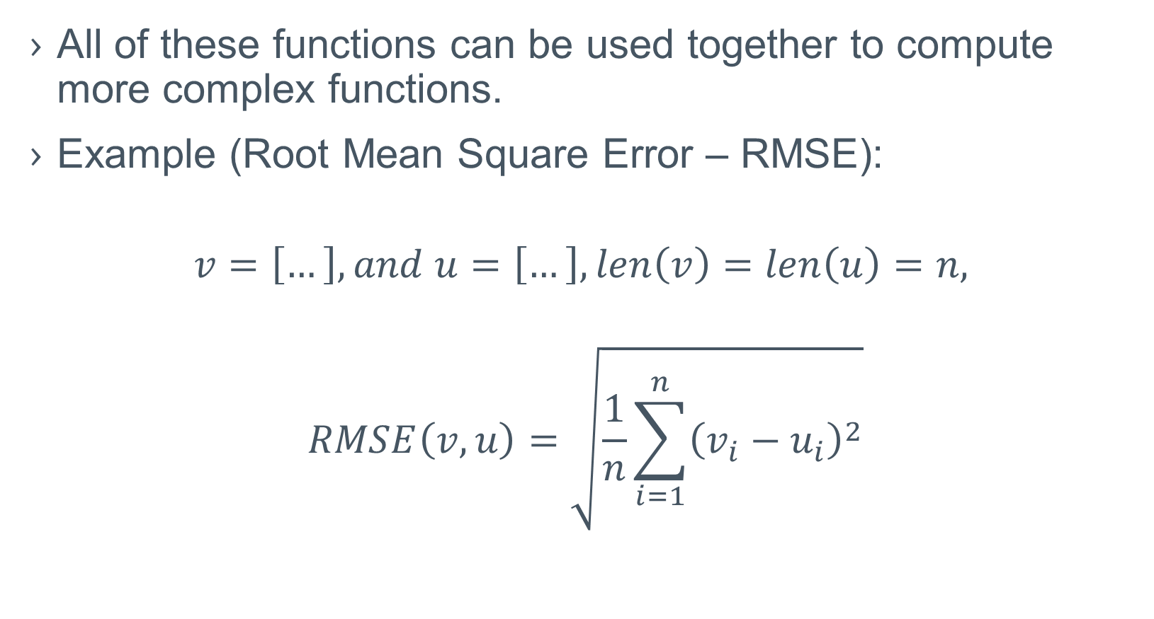
Array operations
All of these functions can be used together to compute more complex functions.
Example (Root Mean Square Error – RMSE):
$$v=\left[…\right], and u=\left[…\right],len\left(v\right)=len\left(u\right)=n,$$
$$RMSE\left(v,u\right)=\sqrt{\frac{1}{n}\sum_{i=1}^{n}{{\left(v_{i}−u_{i}\right)}^{2}}}$$

Slide 133
Array operations
Let’s see how we can write RMSE in numpy
Example :
import numpy as np
v = np.array([1,2,3,4])
u = np.array([5,6,7,8])
# it is assumed the v and u have the same size
rmse = np.sqrt(np.sum(np.square(v-u))/v.size)
print("RMSE = ",rmse)
Output
RMSE = 4

Slide 134
Array operations
Let’s see how we can write RMSE in numpy
Example :
import numpy as np
v = np.array([1,2,3,4])
u = np.array([5,6,7,8])
# it is assumed the v and u have the same size
rmse = np.sqrt(np.sum(np.square(v-u))/v.size)
print("RMSE = ",rmse)
Debug
v-u = [1,2,3,4] – [5,6,7,8] = = [1-5, 2-6, 3-7, 4-8] = = [-4,-4,-4,-4]

Slide 135
Array operations
Let’s see how we can write RMSE in numpy
Example :
import numpy as np
v = np.array([1,2,3,4])
u = np.array([5,6,7,8])
# it is assumed the v and u have the same size
rmse = np.sqrt(np.sum(np.square(v-u))/v.size)
print("RMSE = ",rmse)
Debug
v-u = [1,2,3,4] – [5,6,7,8] = = [1-5, 2-6, 3-7, 4-8] = = [-4,-4,-4,-4]
square(v-u) = [-4²,-4²,-4²,-4²] = [16, 16, 16, 16]

Slide 136
Array operations
Let’s see how we can write RMSE in numpy
Example :
import numpy as np
v = np.array([1,2,3,4])
u = np.array([5,6,7,8])
# it is assumed the v and u have the same size
rmse = np.sqrt(np.sum(np.square(v-u))/v.size)
print("RMSE = ",rmse)
Debug
v-u = [1,2,3,4] – [5,6,7,8] = = [1-5, 2-6, 3-7, 4-8] = = [-4,-4,-4,-4]
square(v-u) = [-4²,-4²,-4²,-4²] = [16, 16, 16, 16]
sum(square(..)) = 16+16+16+16 = 64

Slide 137
Array operations
Let’s see how we can write RMSE in numpy
Example :
import numpy as np
v = np.array([1,2,3,4])
u = np.array([5,6,7,8])
# it is assumed the v and u have the same size
rmse = np.sqrt(np.sum(np.square(v-u))/v.size)
print("RMSE = ",rmse)
Debug
v-u = [1,2,3,4] – [5,6,7,8] = = [1-5, 2-6, 3-7, 4-8] = = [-4,-4,-4,-4]
square(v-u) = [-4²,-4²,-4²,-4²] = [16, 16, 16, 16]
sum(square(..)) = 16+16+16+16 = 64
sum(…)/size = 64 / 4 = 16

Slide 138
Array operations
Let’s see how we can write RMSE in numpy
Example :
import numpy as np
v = np.array([1,2,3,4])
u = np.array([5,6,7,8])
# it is assumed the v and u have the same size
rmse = np.sqrt(np.sum(np.square(v-u))/v.size)
print("RMSE = ",rmse)
Debug
v-u = [1,2,3,4] – [5,6,7,8] = = [1-5, 2-6, 3-7, 4-8] = = [-4,-4,-4,-4]
square(v-u) = [-4²,-4²,-4²,-4²] = [16, 16, 16, 16]
sum(square(..)) = 16+16+16+16 = 64
sum(…)/size = 64 / 4 = 16
sqrt(sum(…)/size) = sqrt(16) = 4

Slide 139
Serialization/Deserialization

Slide 140
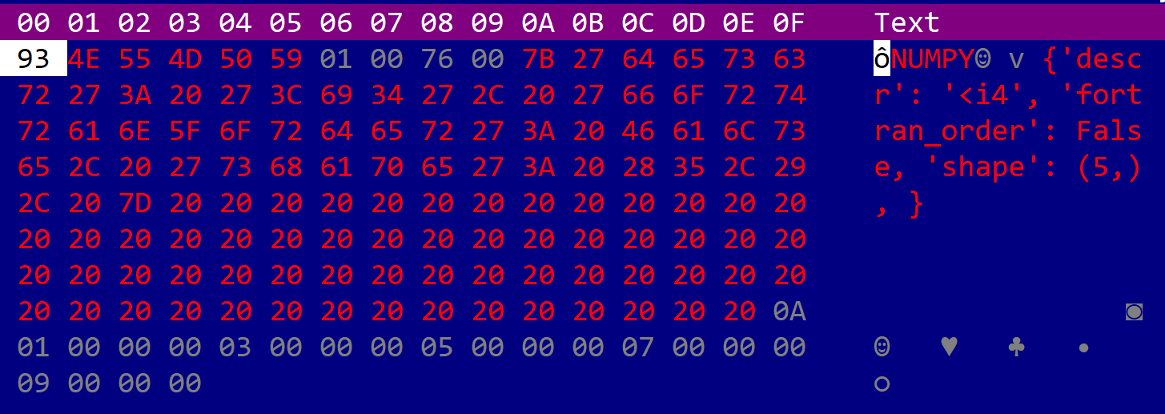
Serialization/Deserialization
Numpy arrays can be saved and loaded to disk. This allows to create checkpoints or to save models. A special extension (.npy) will be added when saving to a file.
Example:
Output
[1 3 5 7 9]
import numpy as np
v = np.array([1,3,5,7,9])
np.save("my_array", v)
u = np.load("my_array.npy")
print(u)
my_array.npy file content

Slide 141
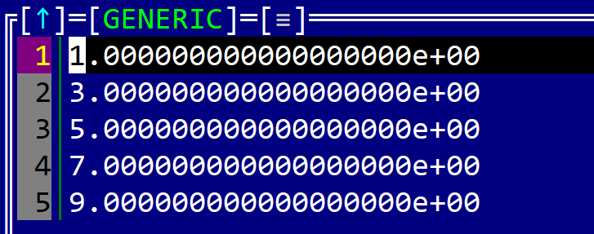
Serialization/Deserialization
While the .save() method saves a file in a binary format, there is another method ( .savetxt(…) ) that can be used to save a file as a text (more suitable for debug purposes).
Example:
Output
[1 3 5 7 9]
import numpy as np
v = np.array([1,3,5,7,9])
np.savetxt("my_array.txt", v)
u = np.loadtxt("my_array.txt")
print(u)
my_array.txt file content

Slide 142
Serialization/Deserialization
In practice, complex models are formed out of multiple arrays (and it is easier to save all of them into an archive than in individual files). For this purpose, there are two methods: .savez(…) and .savez_compressed(…) (“z” stands for zip). The default extension will be npz
Example:
Content of my_arrays.npz
vector1.npy
vector2.npy
matrix1.npy
import numpy as np
v = np.array([1,3,5,7,9])
u = np.array([[1,3],[5,7]])
t = np.array([1,2,3])
np.savez("my_arrays", vector1=v, matrix1=u, vector2=t)

Slide 143
Serialization/Deserialization
In practice, complex models are form out of multiple arrays (and it is easier to save all of them into an archive than in individual files). For this purpose, there are two methods: .savez(…) and .savez_compressed(…) (“z” stands for zip). The default extension will be npz
Example:
Content of my_arrays.npz
vector1.npy
vector2.npy
matrix1.npy
import numpy as np
v = np.array([1,3,5,7,9])
u = np.array([[1,3],[5,7]])
t = np.array([1,2,3])
np.savez("my_arrays", vector1=v, matrix1=u, vector2=t)
Array “u” will be stored in this file

Slide 144
Serialization/Deserialization
To load a zip archive, create by the previous code, we can use the np.load(…) method and the property `files` (to access all arrays).
Example:
Output
['vector1', 'matrix1', 'vector2'] vector1 = [1 3 5 7 9] matrix1 = [[1 3] [5 7]] vector2 = [1 2 3]
import numpy as np
data = np.load("my_arrays.npz")
print(data.files)
for fname in data.files:
print(fname+" = ",data[fname])

Slide 145
Serialization/Deserialization
Another interesting method is .genfromtxt(…) with the following definition:
numpy.genfromtxt( fname,
dtype=<class 'float’>,
comments='#’,
delimiter=None,
skip_header=0,
skip_footer=0,
missing_values=None,
filling_values=None,
usecols=None,
replace_space='_’,
case_sensitive=True,
…
)

Slide 146
Serialization/Deserialization
This method ( .genfromtxt(…) ) can be used to load data in a list format files (such as a .csv or .tsv file) into an array or matrix.
Some examples:
import numpy as np
# Load data from a regular cvs file with no headers
array = np.genfromtxt('csv_file.csv', delimiter=',')
# Load data from a cvs file with headers
array = np.genfromtxt('csv_file.csv', delimiter=',', skip_header=1)

Slide 147
Questions?

